Slide 1
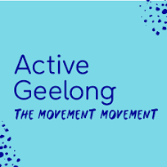


ACTIVE WORKPLACES
UNDERSTANDING WORKER’S PHYSICAL ACTIVITY IN RELATION TO THE WORKPLACE
COBRAM ESTATE OLIVES, MAY 2023

Slide 2
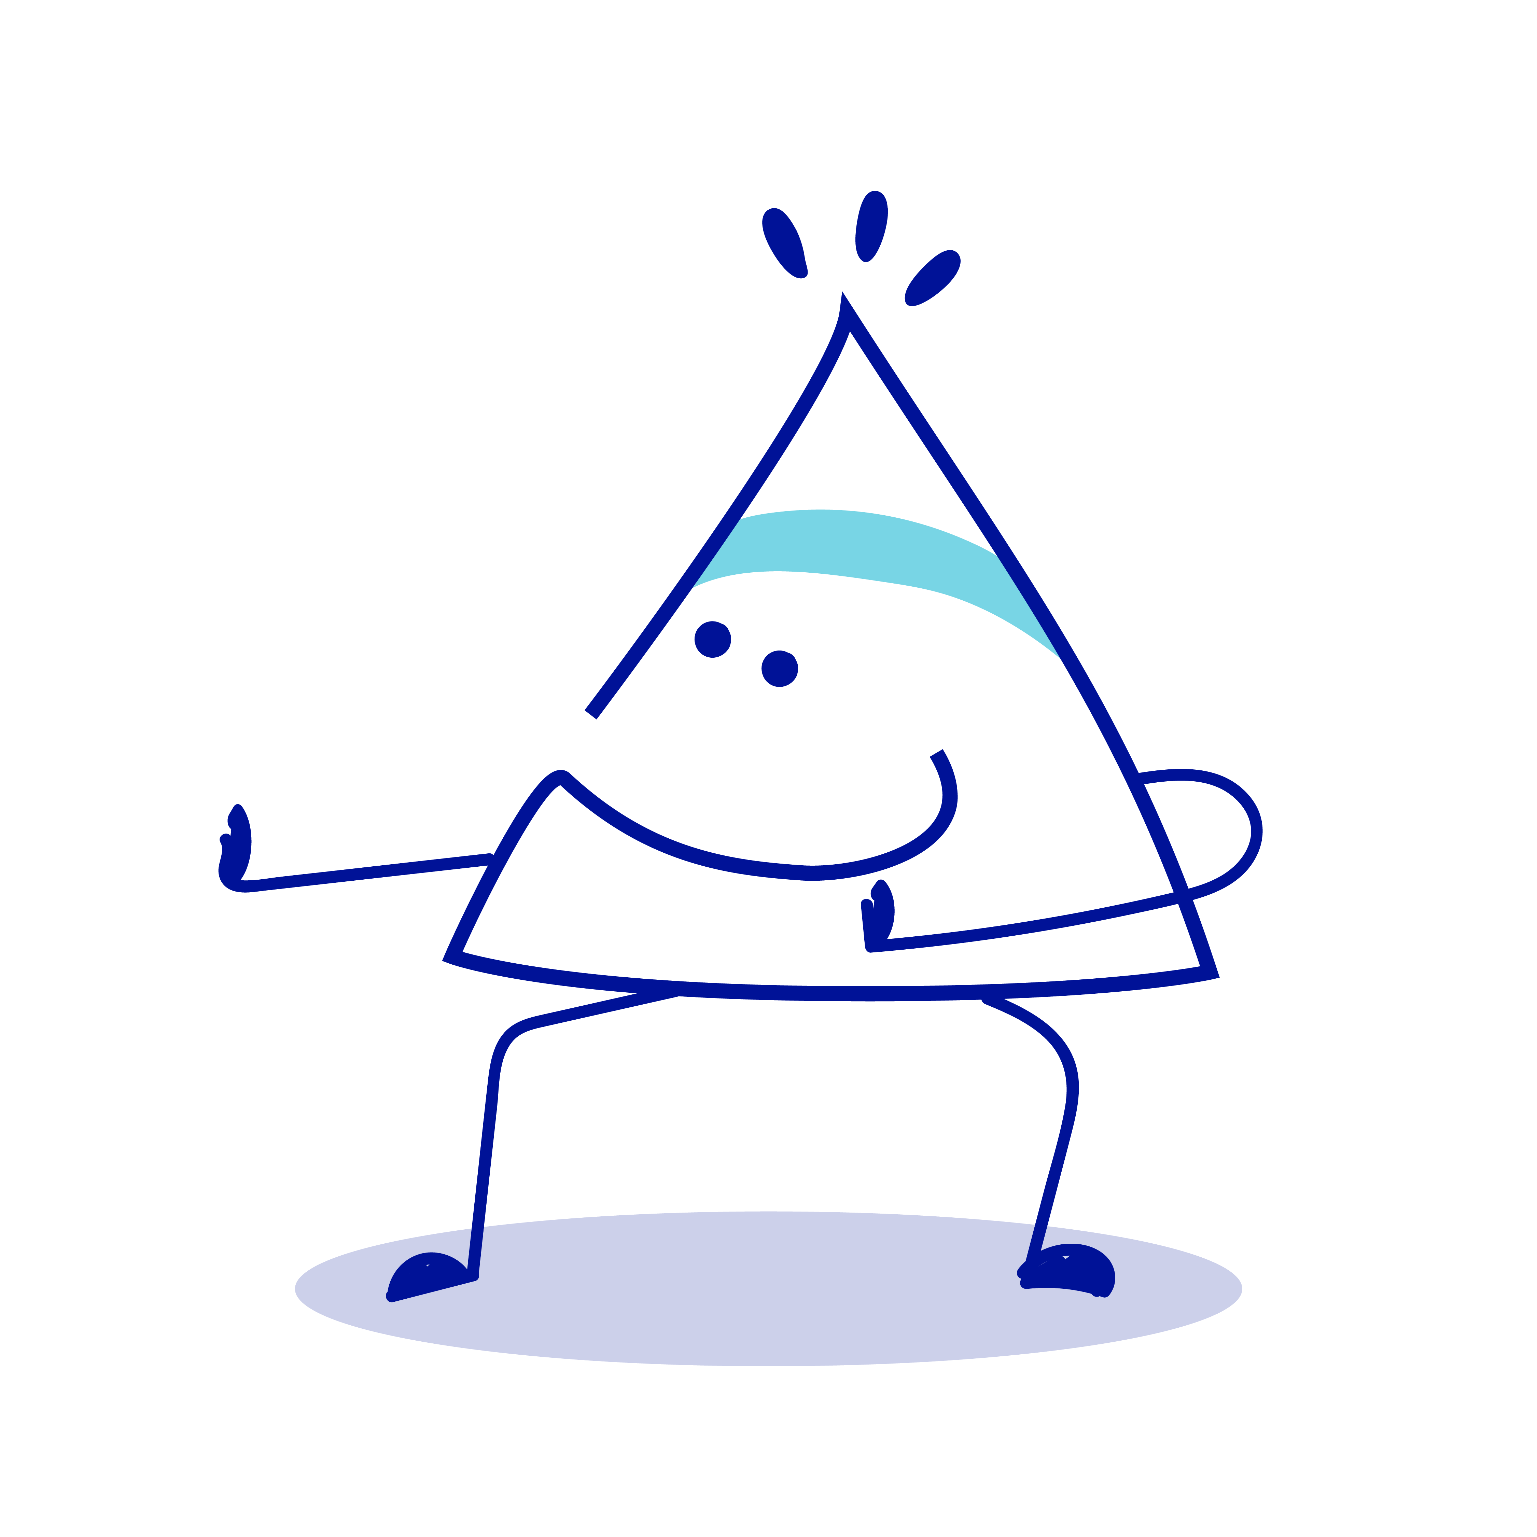

ABOUT THE PARTNERS
BARWON HEALTH HEALTHY COMMUNITIES TEAM
Barwon Health Healthy Communities team works with our community to create environments that promote health. We support local workplaces to achieve better health and wellbeing outcomes for their staff. A healthy workplace and healthy staff are great for business, the local economy and a thriving community.
We are partnering with Active Geelong to create a range of new opportunities and initiatives to improve the health of local workers by increasing physical activity.

Slide 3
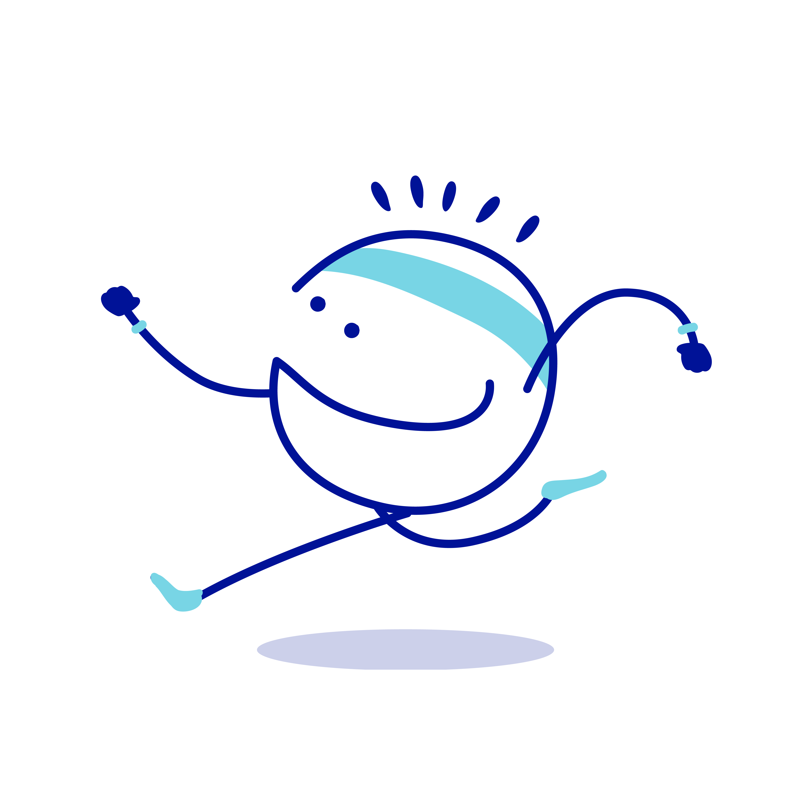
ABOUT THE PARTNERS
ACTIVE GEELONG
Active Geelong is a health collaboration bringing together leading businesses, doctors, researchers and individuals to address physical activity in the Geelong region.
We work with workplaces, local health professionals and the broader community to increase access to new and existing opportunities and activities that promote physical activity.

Slide 4
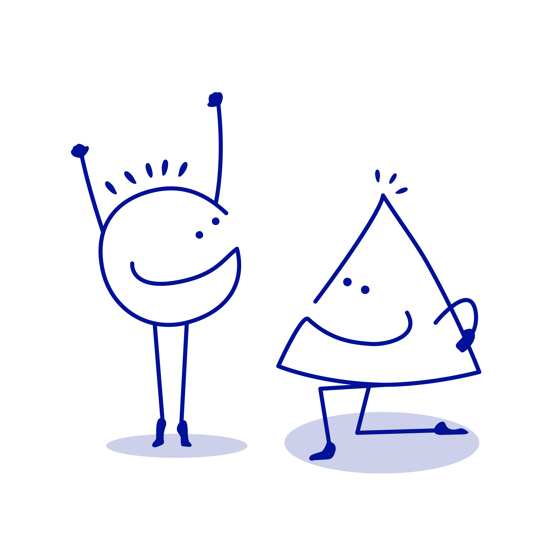
ABOUT THE WORKPLACE
COBRAM ESTATE OLIVES
Cobram Estate Olives Ltd is Australia’s largest olive farmer with over 2.4 million olive trees planted on 6,584 hectares of freehold farmland producing an estimated 72% of Australia’s total olive crop in 2022. Olive growing operations are located at Boundary Bend (between Mildura and Swan Hill), Boort (near Bendigo) and Wemen (between Mildura and Swan Hill).
With a total of 120 permanent staff in their Australian operations, approximately 50 staff are located at the nine hectare head office and industrial facility in Lara. On this site, workers are employed within Finance, People & Culture, Laboratory, Supply Chain, Administration, Bottling, Manufacturing, Warehouse, Refinery and Nursery work areas.

Slide 5
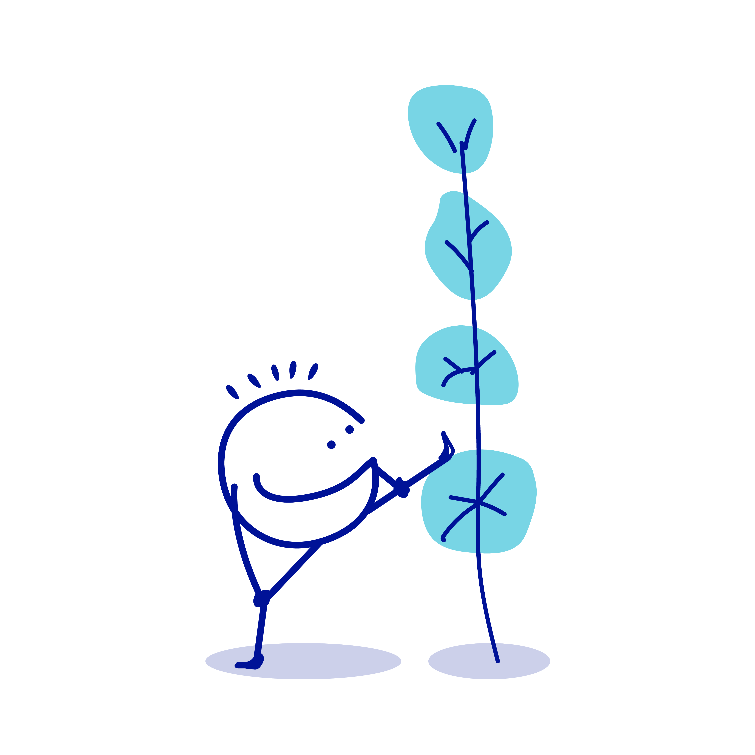
WHY DOES GEELONG NEED TO BE MORE ACTIVE
In 2021, 33% of the Geelong population did not undertake adequate physical activity to meet national physical activity guidelines (which recommend participating in 30-60 minutes of physical activity on at least 5 days of the week). 21% were categorised as sedentary, that is, reporting no physical activity (an increase of 10% since the prior survey in 2017).
Physical inactivity is the 9th leading preventable cause of ill health and premature death, responsible for 2.5% of total disease burden in Australia, in 2018.
Physical inactivity increases the risk of many diseases and is linked to the burden from type 2 diabetes, bowel cancer, dementia, coronary heart disease and strokes, as well as uterine and breast cancer in females.
City of Greater Geelong (2021) Geelong Preventative Health Survey 2021 LGA Summary Report, https://www.geelongaustralia.com.au/gphs/documents/item/8d9a8466b3d2832.aspx
AIHW (2021) Physical activity https://www.aihw.gov.au/reports/australias-health/insufficient-physical-activity

Slide 6
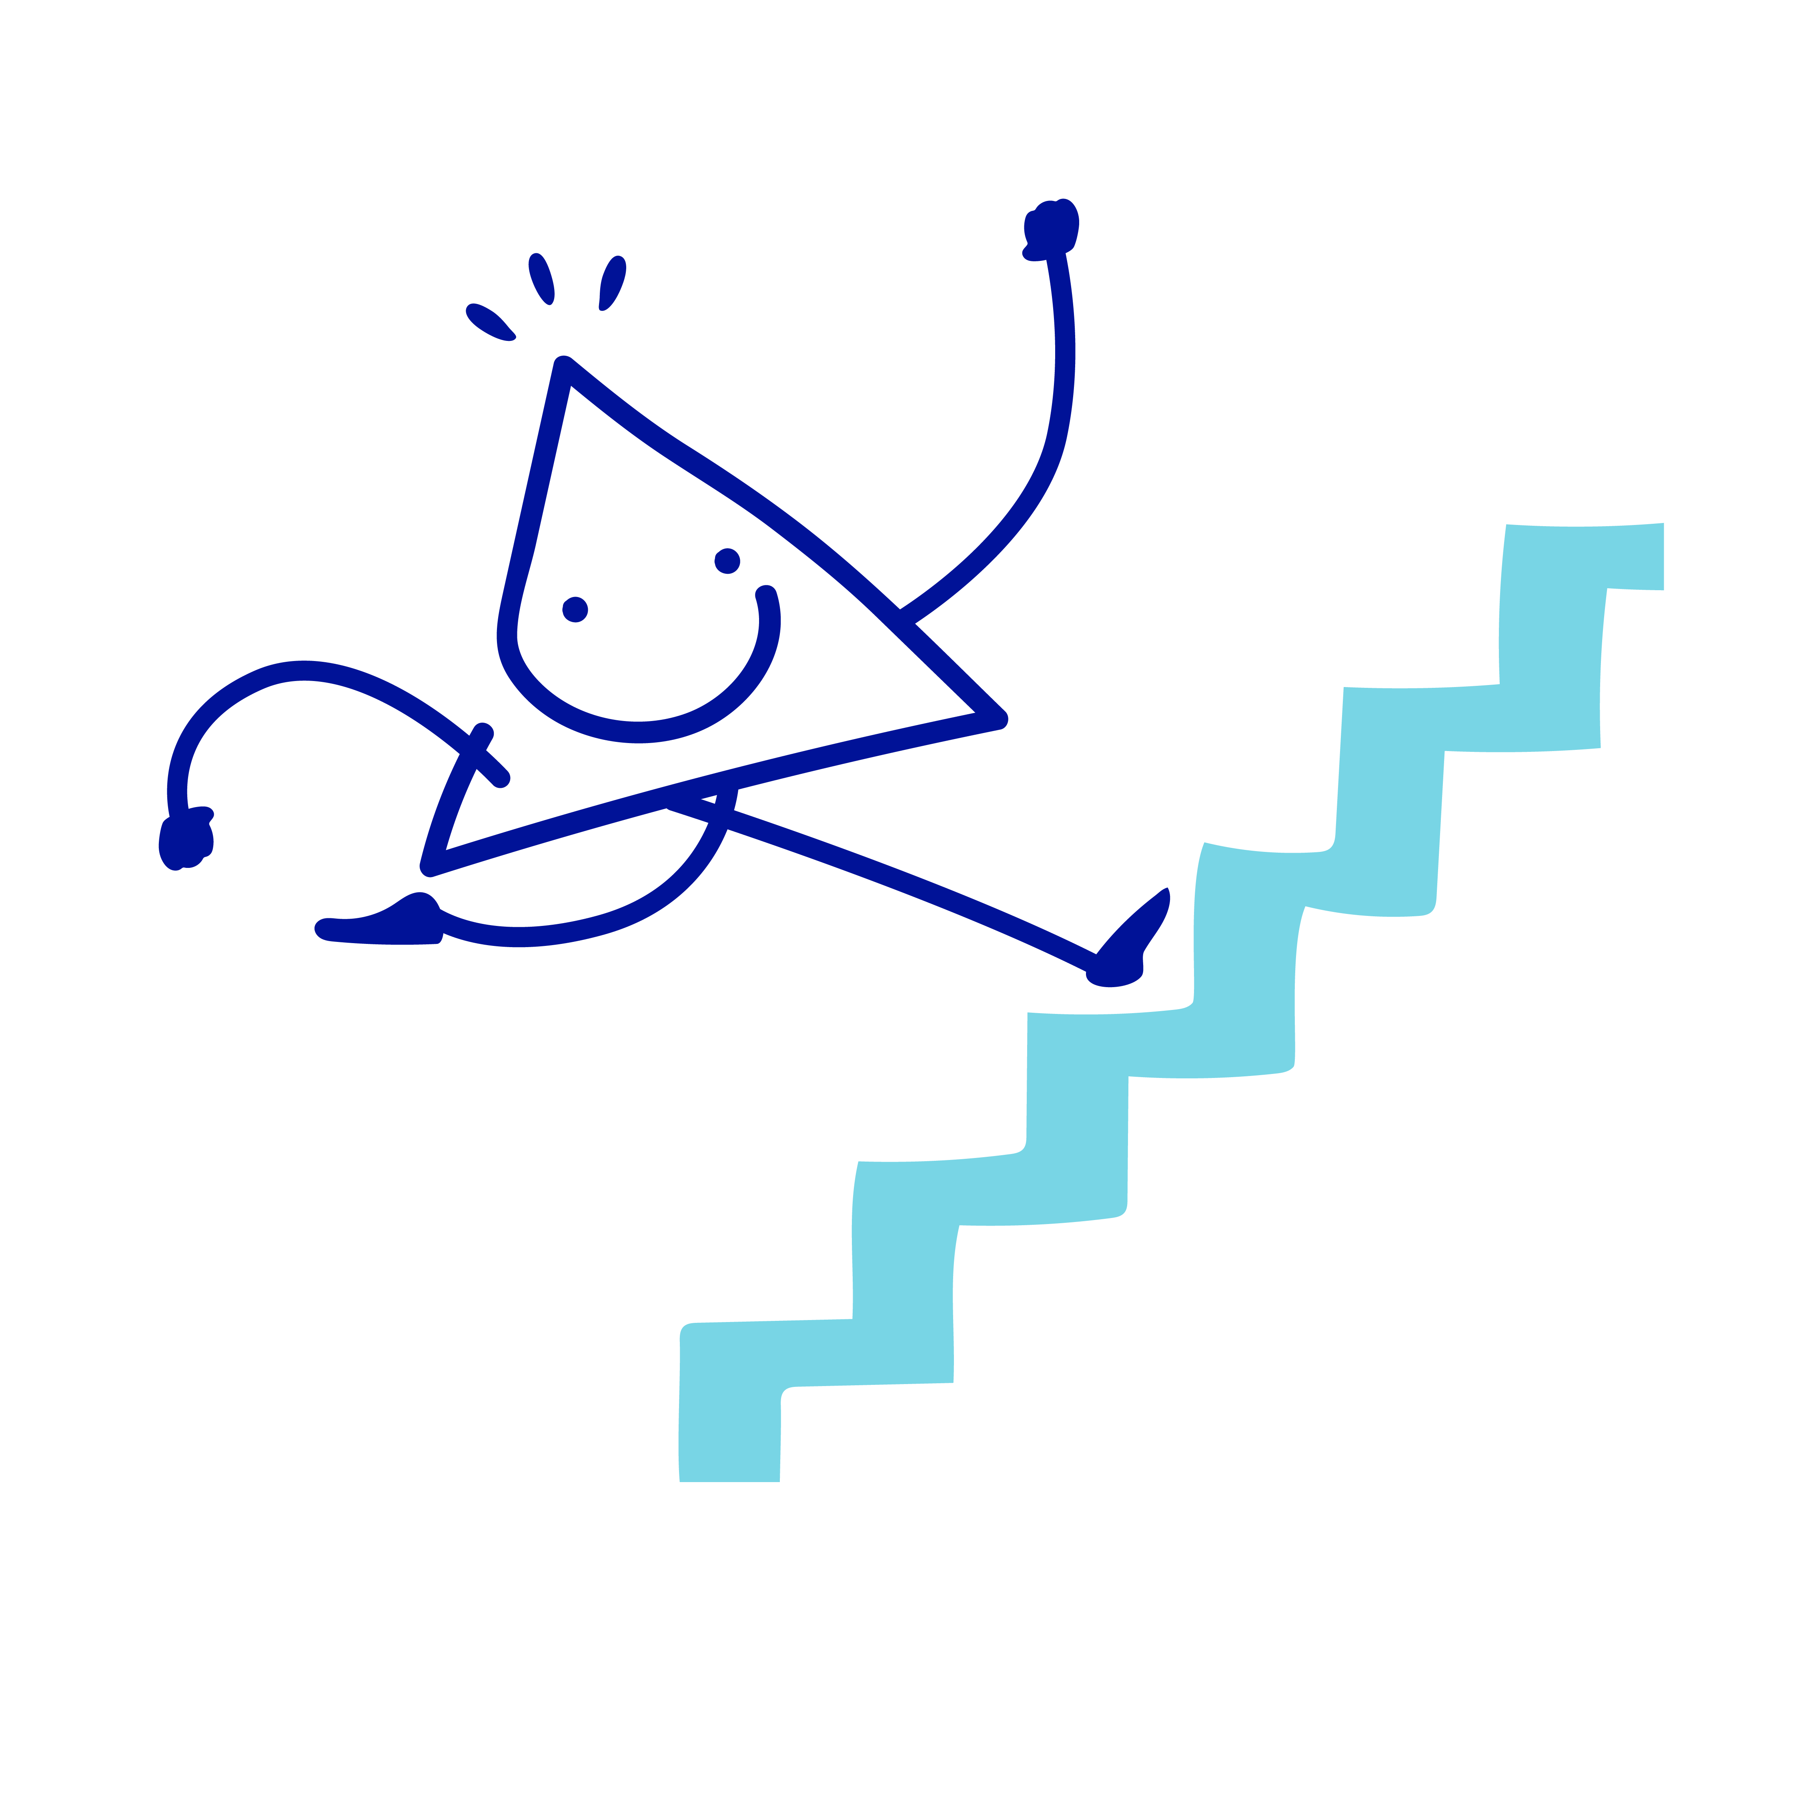
HOW BEING ACTIVE BENEFITS THE GEELONG BUSINESS COMMUNITY
Healthy and higher performing employees
A demonstrated commitment to action that benefits
the welfare of their people, and position themselves
as an ‘Employer of Choice’ for local talent
An opportunity for positive communication between
staff and management
Improved staff morale leading to higher levels
of productivity
Retention of skilled workforce
Healthy staff are healthy community members, contributing to the local business economy and a thriving community.
Whilst the health benefits for individuals who are physically active are well known, there are also significant benefits for business and the Geelong economy including:

Slide 7
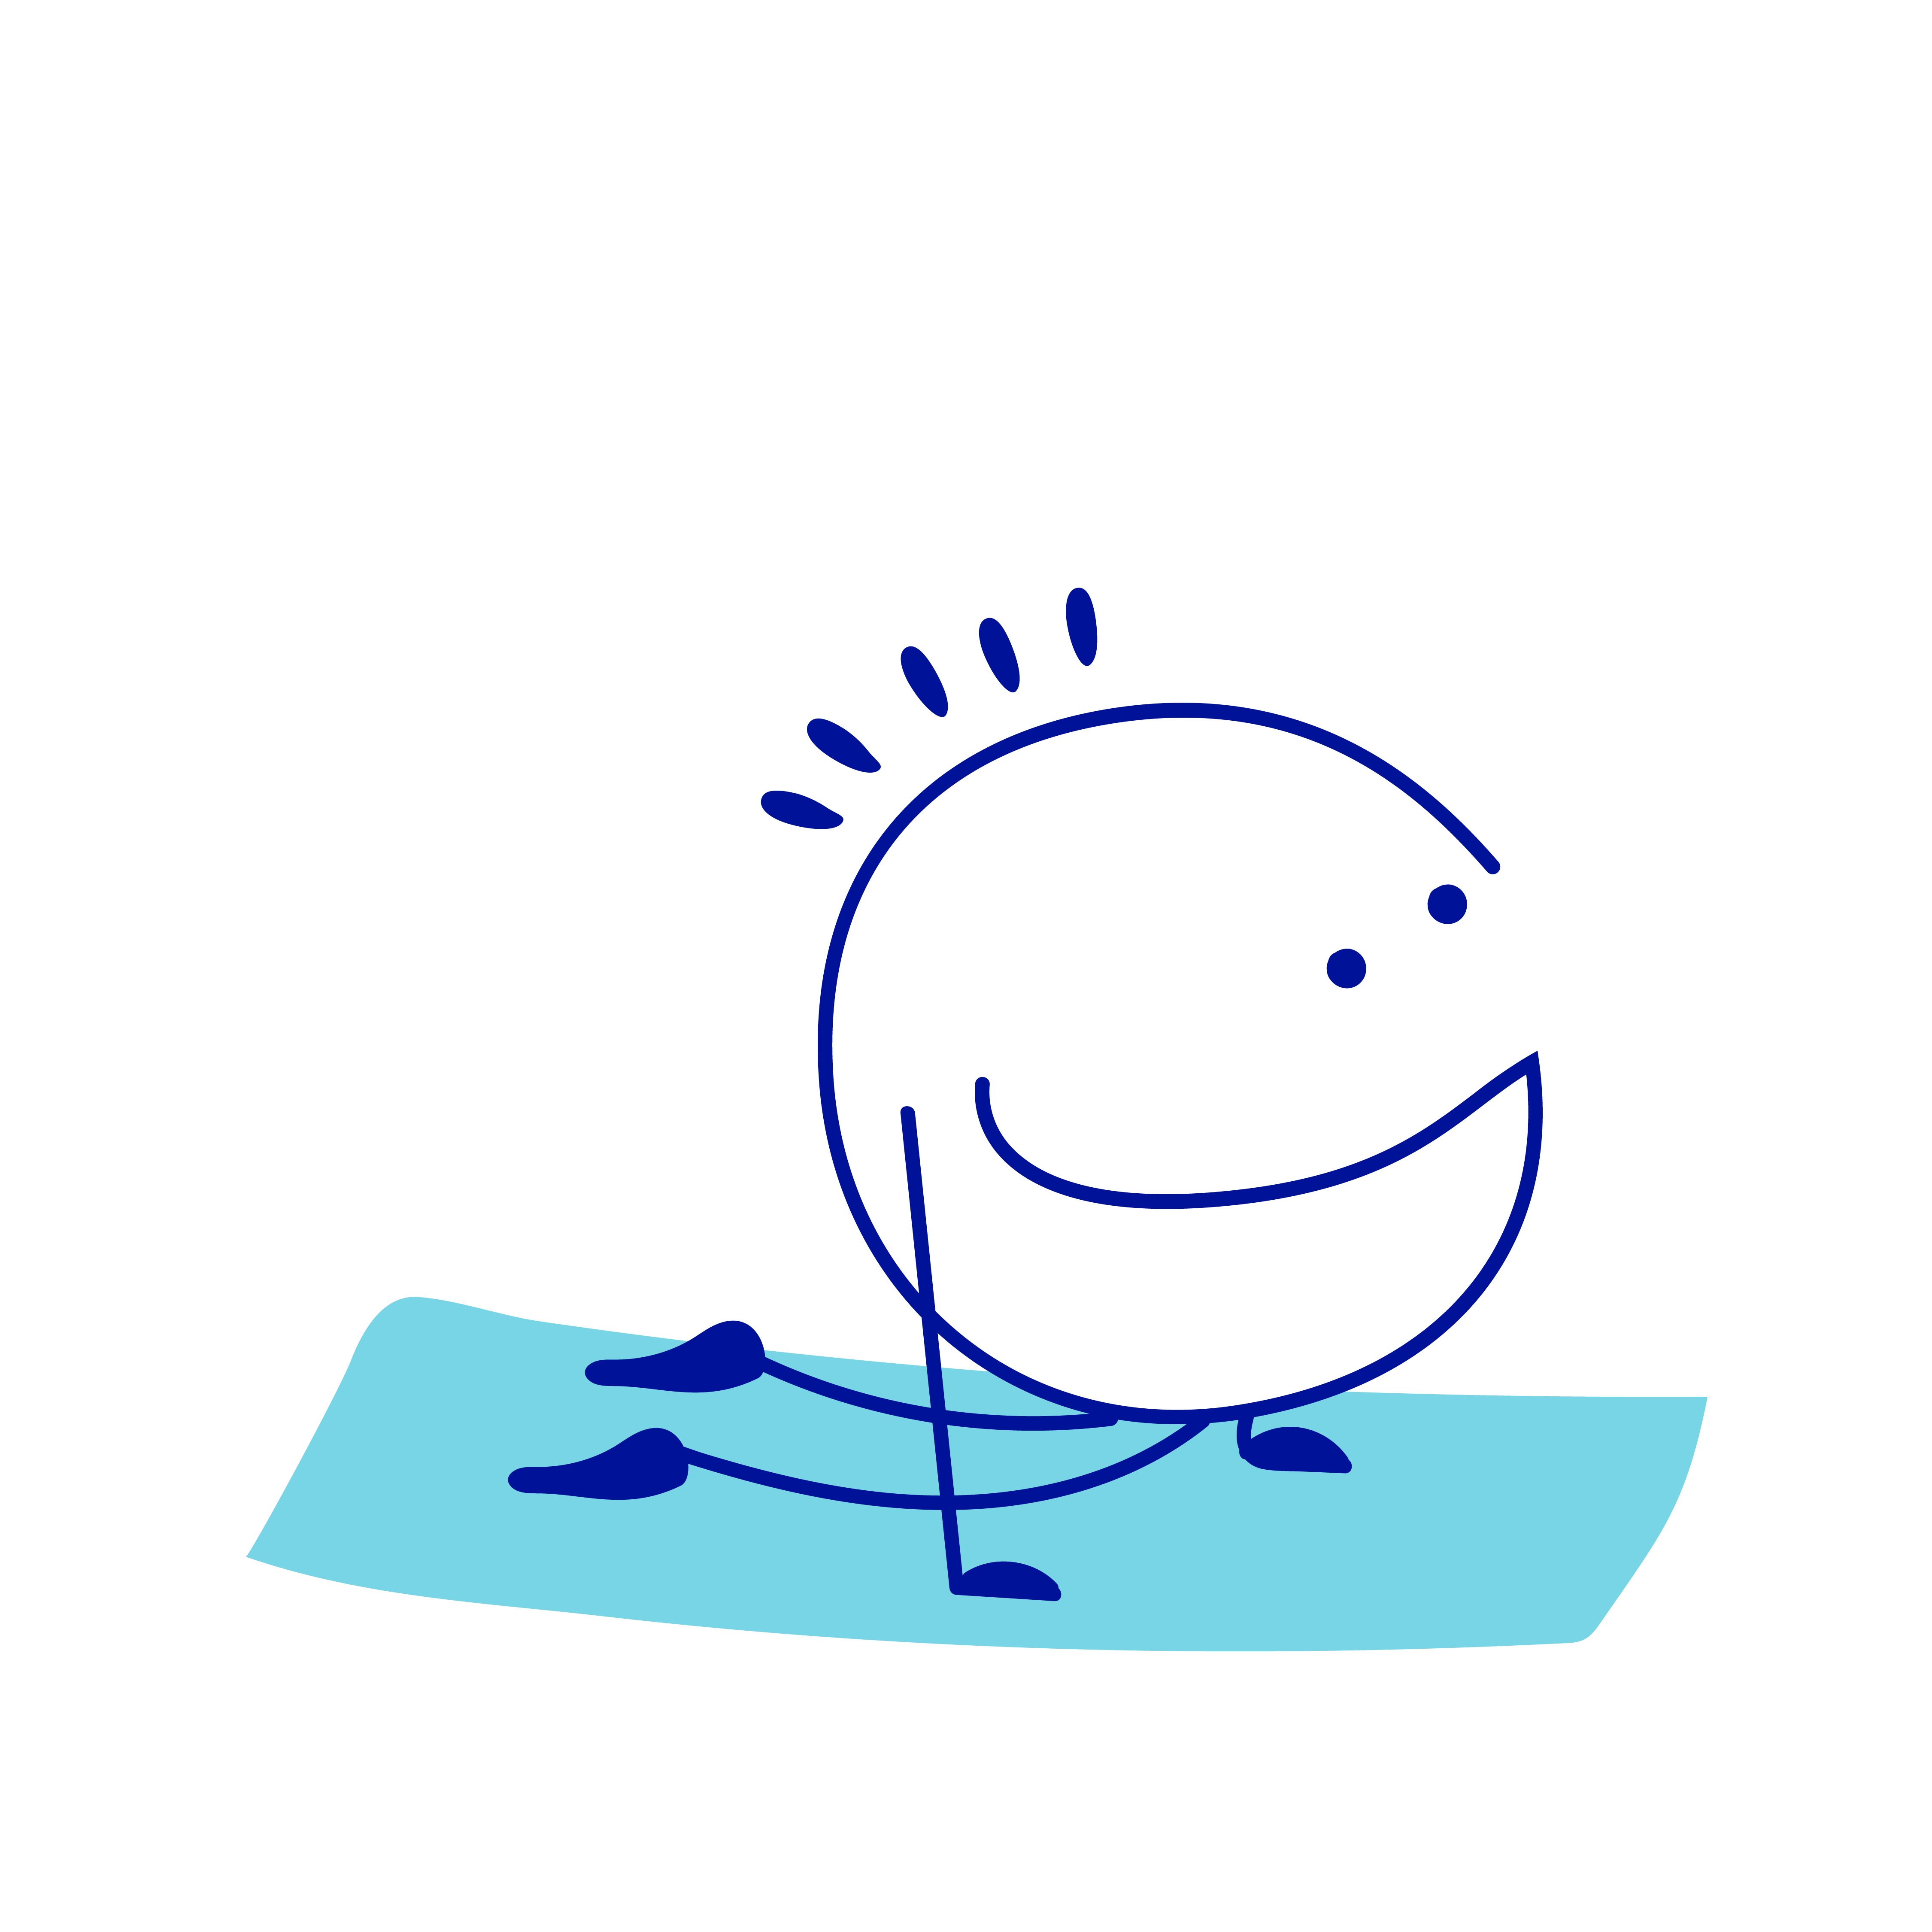
HOW BEING ACTIVE BENEFITS THE GEELONG BUSINESS COMMUNITY
Workplaces can support their staff to be physically active by creating an environment and culture that enables physical activity and reduces sedentary behaviour.
Since the pandemic in 2020, many workplaces are operating in a ‘hybrid’ environment. It is more important than ever to approach workplace physical activity strategies in an innovative, holistic and personalised way to engage and retain talent.

Slide 8
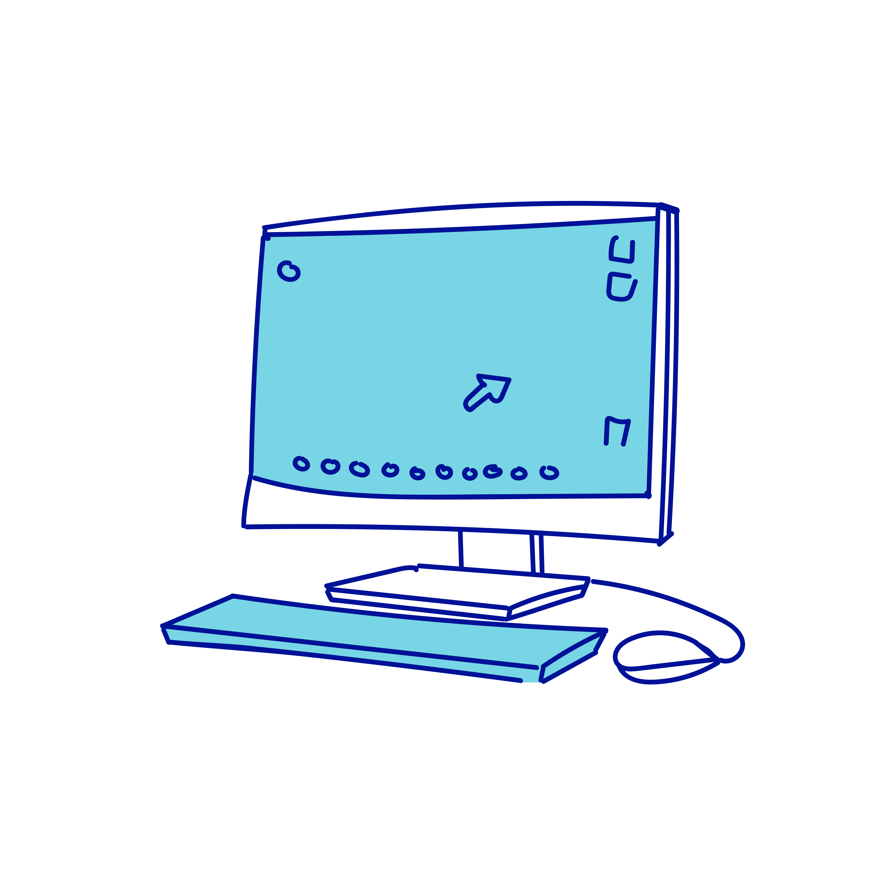
OUTCOMES FOR COBRAM ESTATE OLIVES
An in depth understanding and visual map of the barriers and enablers to physical activity specific to your workforce.
Identified and prioritised action ideas to increase physical activity and wellbeing of workers.
An engaged and inspired group of employees who have worked collaboratively to build the visual map.
Ongoing support from Active Geelong and Barwon Health Healthy Communities Team.
Demonstrated commitment to staff health which can be used to promote Cobram Estate Olives Ltd as an employer of choice in our region.
Satisfaction of being a leader in the Geelong business community through your role in making Geelong Australia’s most active city.

Slide 9

KEY PLAYERS
COBRAM ESTATE OLIVES
Kate Quinlan: Head People & Culture
Justin Pilgrim: Sustainability Manager
Claudia Cook: People & Culture Advisor
ACTIVE GEELONG
Michelle Hemley: Executive Support
BARWON HEALTH HEALTHY COMMUNITIES
Workshop Facilitation Team
Rowena Rittinger: Health Promotion Officer
Karmen Howard: Health Promotion Officer
Ashley Perez: Health Promotion Officer
Zelda Farley: Evaluation Officer
PARTICIPANTS
12 Cobram Estate Olives workers from a range
of work areas and roles including nursery, e-commerce, warehousing, production, refinery, laboratory and administrative staff

Slide 10
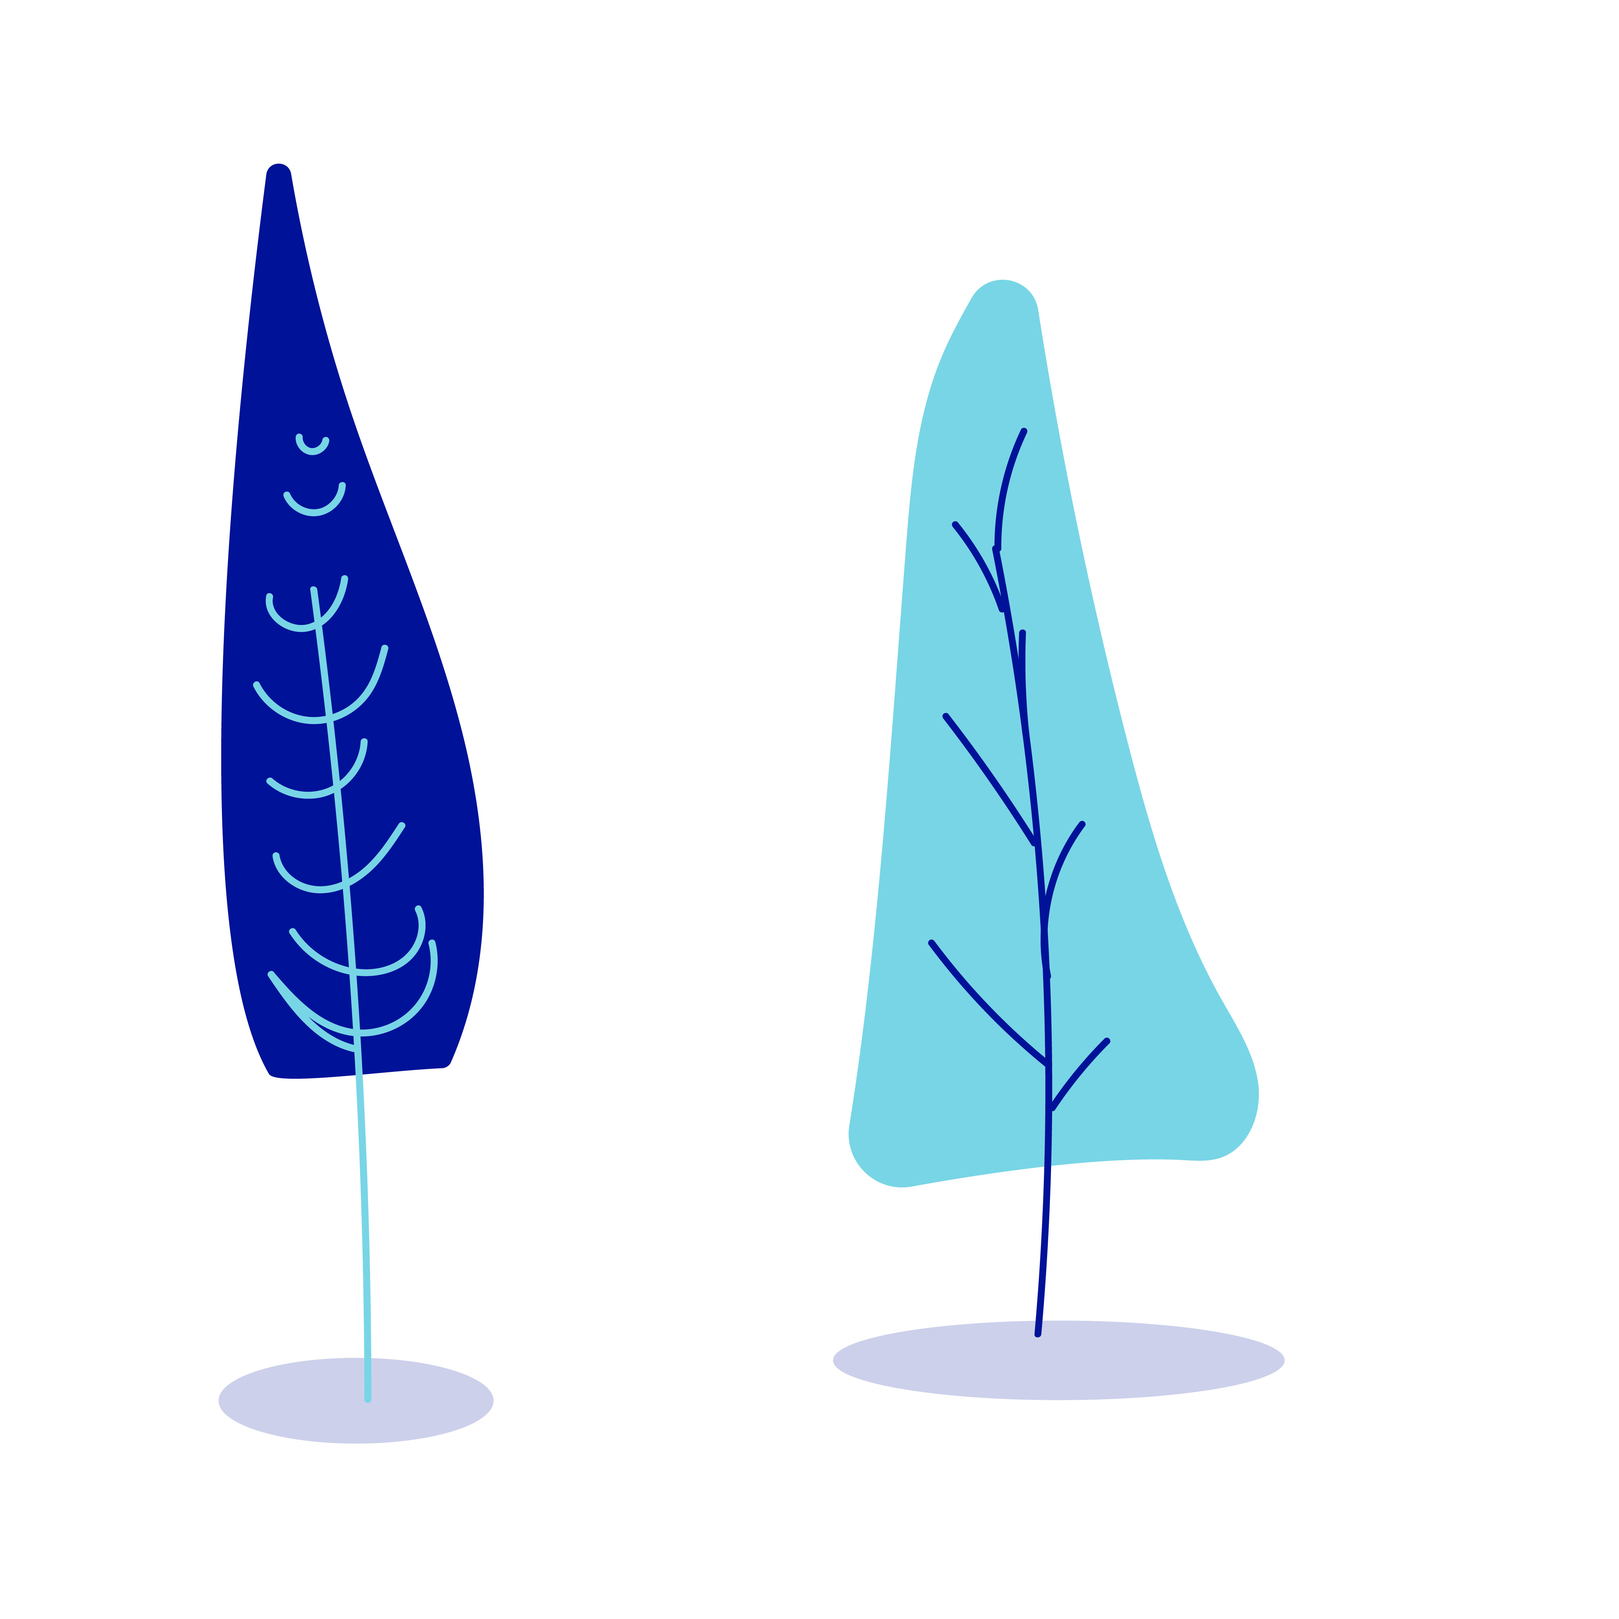
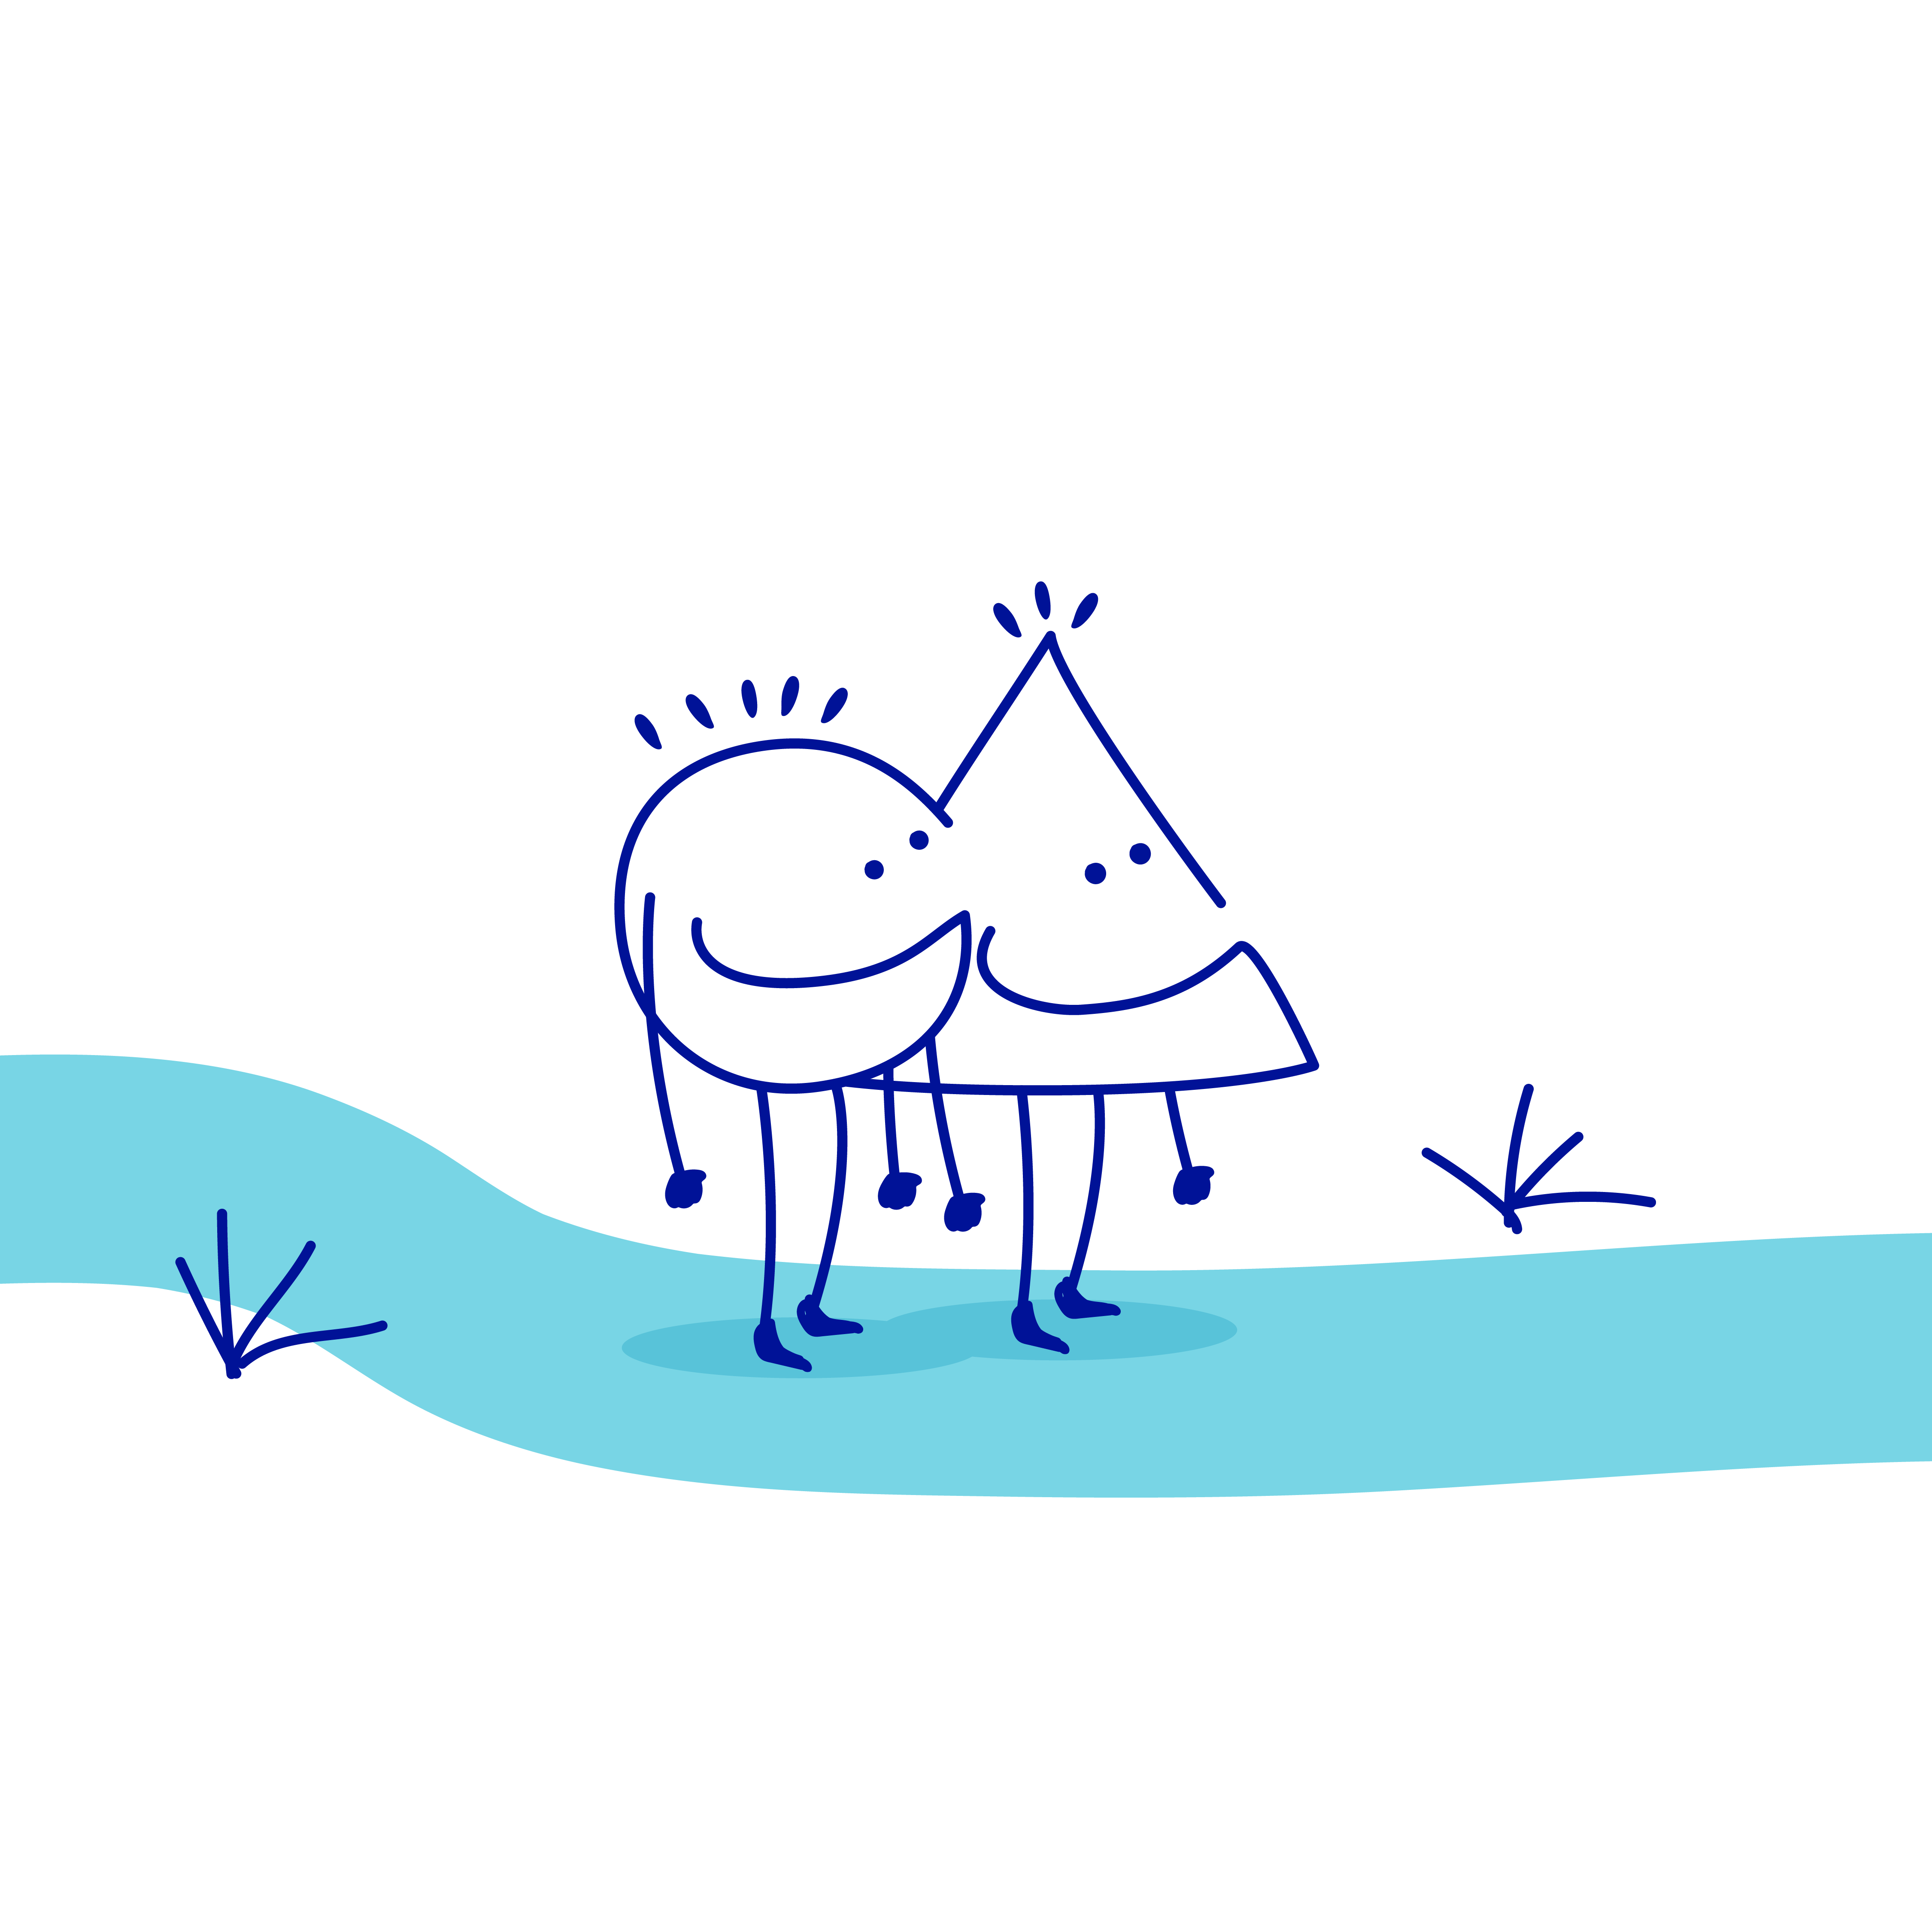
WORKSHOP 1
v
DEVELOPING THE COBRAM ESTATE OLIVES MAP
MAY 5 2023

Slide 11
WORKSHOP 1
Objective: To get an understanding of the factors influencing the physical activity of workers at Cobram Estate Olives, Lara.
A series of activities were conducted where participants identified factors affecting workers’ physical activity at Cobram Estate Olives, and how those factors were connected to one another.
An initial Active Workplace Map was created in the first workshop, and the session concluded with a review of the map produced, and an explanation of the following session.

Slide 12

WORKSHOP 1
STORIES THAT EMERGED
IN THE CONSULTATION
Four key themes emerged from the factors identified by participants in workshop one:
WORK ROLE and WORK LOAD (job related factors),
FACILITIES AVAILABLE on site and in local community, and
INDIVIDUAL VARIABLES such as employment hours, mental wellbeing, motivation and family commitments.

Slide 13
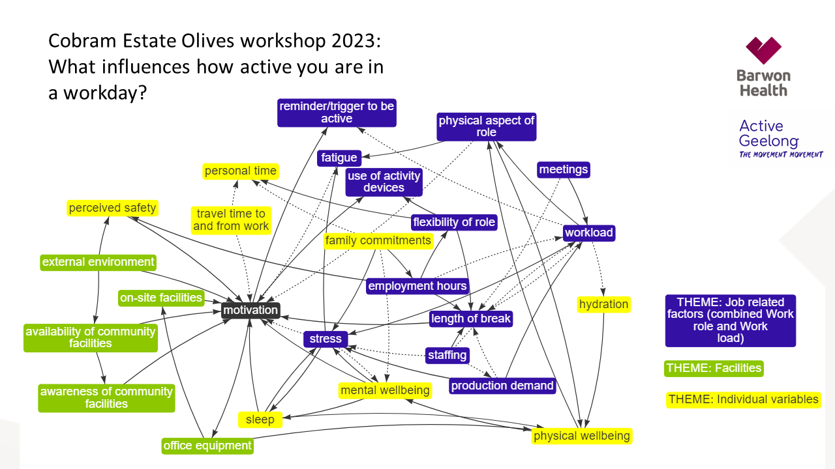
WHAT INFLUENCES HOW ACTIVE YOU ARE IN A WORKDAY?
ABOUT THE PARTNERS
COBRAM ESTATE OLIVES
WORKPLACE MAP

Slide 14
WORKSHOP 1
THEME: WORKLOAD
Participants discussed how their workload was pivotal in how physically active they could be at work. Factors such as production demands, harvest, marketing campaigns and promotion, sample testing, staffing, demands of meetings and the hours they are employed, impacted on their workload and how able they were to take to breaks which would enable physical activities such as going for a walk or run at lunchtime. Participants also acknowledged higher workload can lead to more feelings of stress and fatigue, and impact on how motivated they are to be physically active.

Slide 15
WORKSHOP 1
THEME: WORKLOAD
“…more work I tend to have less time to be active or less time to think about being active”
v
“When the samples come in that has to get done on the day I can’t let it sit so it determines what I do for the day”

Slide 16
WORKSHOP 1
THEME: WORKLOAD
“Specifically in production, time (is a factor). If we need to put an order out or if schedules change, we have a week to run the product, and then no, we need to pull it short…Time is crucial for us to get it done quickly to meet customer needs.”
v

Slide 17
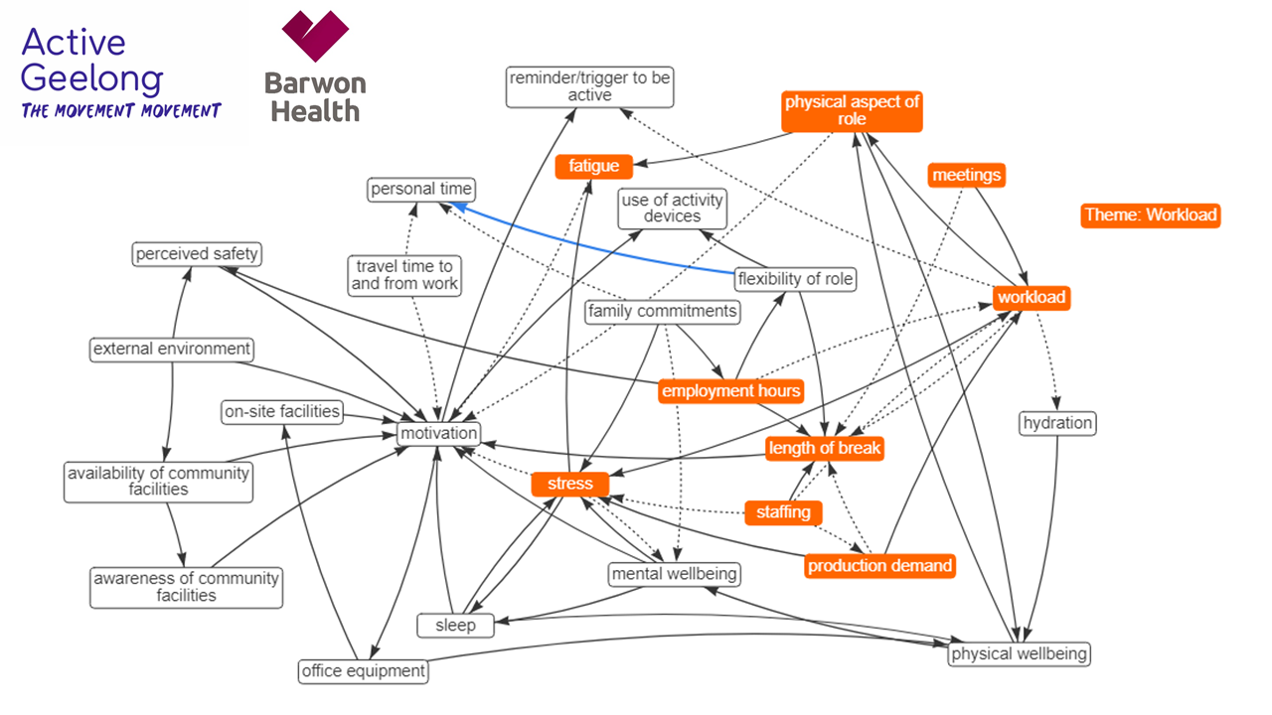
ABOUT THE PARTNERS
COBRAM ESTATE OLIVES
WORKPLACE MAP

Slide 18
WORKSHOP 1
THEME: WORK ROLE
Participants discussed how the type of role a worker has impacts on how much they are or can be physically active at work. Flexibility of the worker’s role in terms of being able to manipulate start and finish times and the structure of the work day, and the length of the break that can be taken were key factors influencing how active workers were. Participants acknowledged that the nature of the work role will inherently impact on your physical activity at work e.g. a worker in production/warehousing compared to an office based worker. There was also discussion how activity devices can be used as a reminder to move more, however some work roles are not permitted to wear such devices.

Slide 19
WORKSHOP 1
THEME: WORK ROLE
“I do try and get up and stretch where I can. Because your job is physical maybe you already do that but I am sitting at a desk”
“As a part timer I work 5 hours, I don’t have time to go somewhere to go for a walk”

Slide 20
WORKSHOP 1
THEME: WORK ROLE
“…in production once harvest starts we have our skates on once the oil is produced, for finance its EOFY, (for) nursery its they have production time”
“We don’t get an hour as a break, we get 3 different breaks. If there was an opportunity to go for a run at lunch we can’t. My role out there, I can’t take an hour I have to be there.”

Slide 21
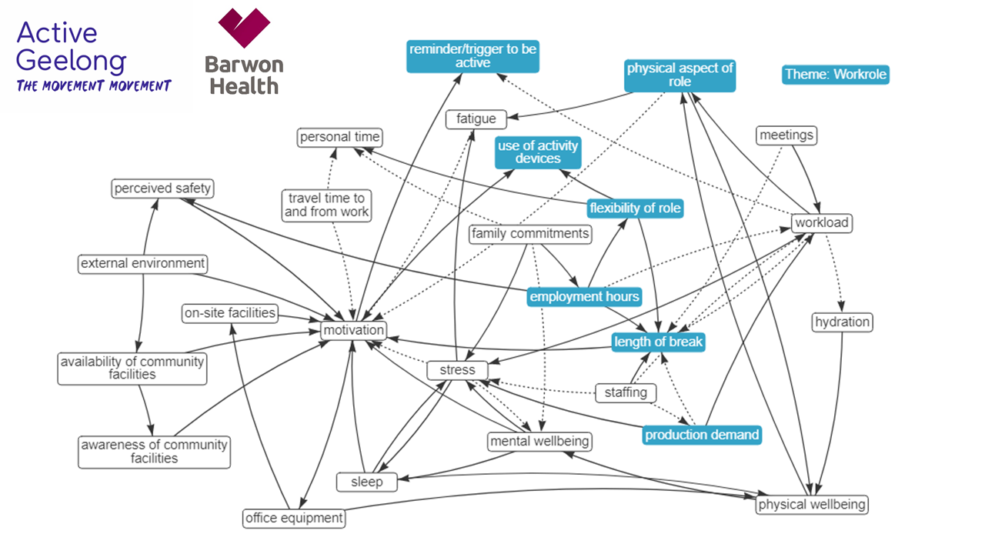
COBRAM ESTATE MAP
WORK ROLE
ABOUT THE PARTNERS

Slide 22
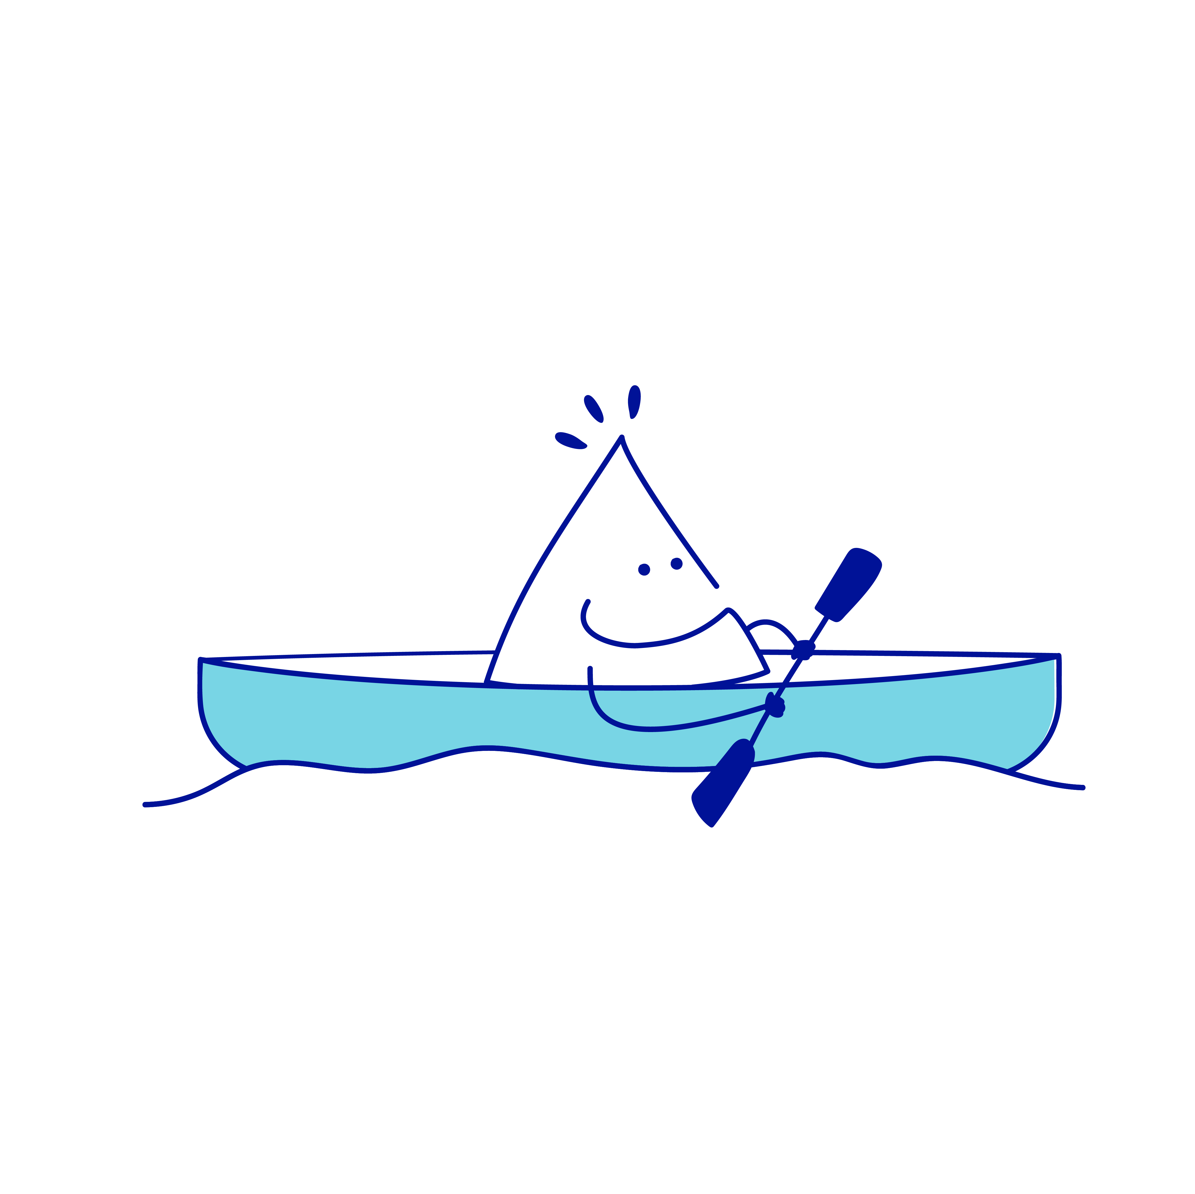
WORKSHOP 1
THEME: FACILITIES AVAILABLE
Participants identified lack of onsite shower facilities as a key barrier to exercising in their workday, and this was also heavily linked to motivation to be physically active at work. The impact of the weather was also emphasised as a barrier to be able to go for a walk or a run during their work hours. Participants recognised that they were not aware of all the local community facilities available nearby, and that some of these are only seasonally operated.

Slide 23
WORKSHOP 1
THEME: FACILITIES AVAILABLE
“There is no shower here, no facilities to support. If you go workout on your lunch-break coming back in sweat. The boys take a deodorant shower (shower in a can). You don’t want to go back and sit at your desk all stinky”
“Lara pool closes over winter. Sometimes that is an option I could use but there is times where it is shut, it’s down the road… I won’t go into Geelong but I will go to Lara. They also have showers. “

Slide 24
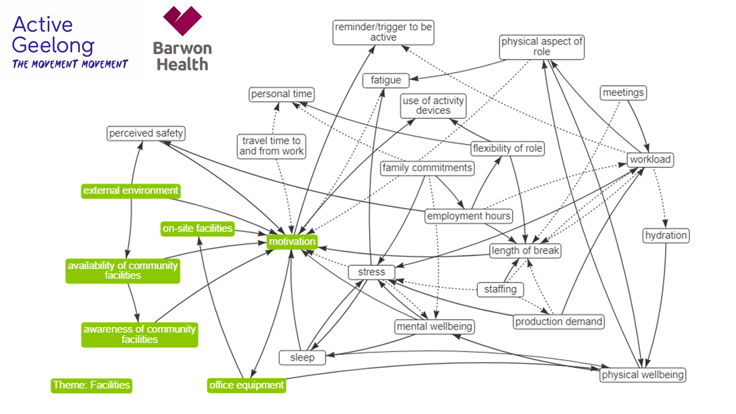
COBRAM ESTATE OLIVES
FACILITIES AVAILABLE
ABOUT THE PARTNERS

Slide 25

WORKSHOP 1
THEME: INDIVIDUAL VARIABLES
Participants spoke about factors such as sleep, hydration, family commitments and distance travelled to work that can influence their general wellbeing and motivation to be active at work. Being part time with fewer hours on site to complete work tasks impacted on being able to exercise during work hours, and external commitments affected how they engaged with physical activity outside of work hours. The group also acknowledged that mental wellbeing, stress and fatigue all impacted on how motivated they are to be physically active. Some participants reported that using activity devices (watches) were helpful to some to remind them to move during the work day, however it was acknowledged that not all work areas are able to wear such devices due to health and safety reasons.

Slide 26
WORKSHOP 1
THEME: INDIVIDUAL VARIABLES
“How I am feeling - if I am feeling tired I am not motivated”
v
“How we are feeling mentally, for me I have mental health issues so if I am having a bad day I just want to do my work and get home”

Slide 27
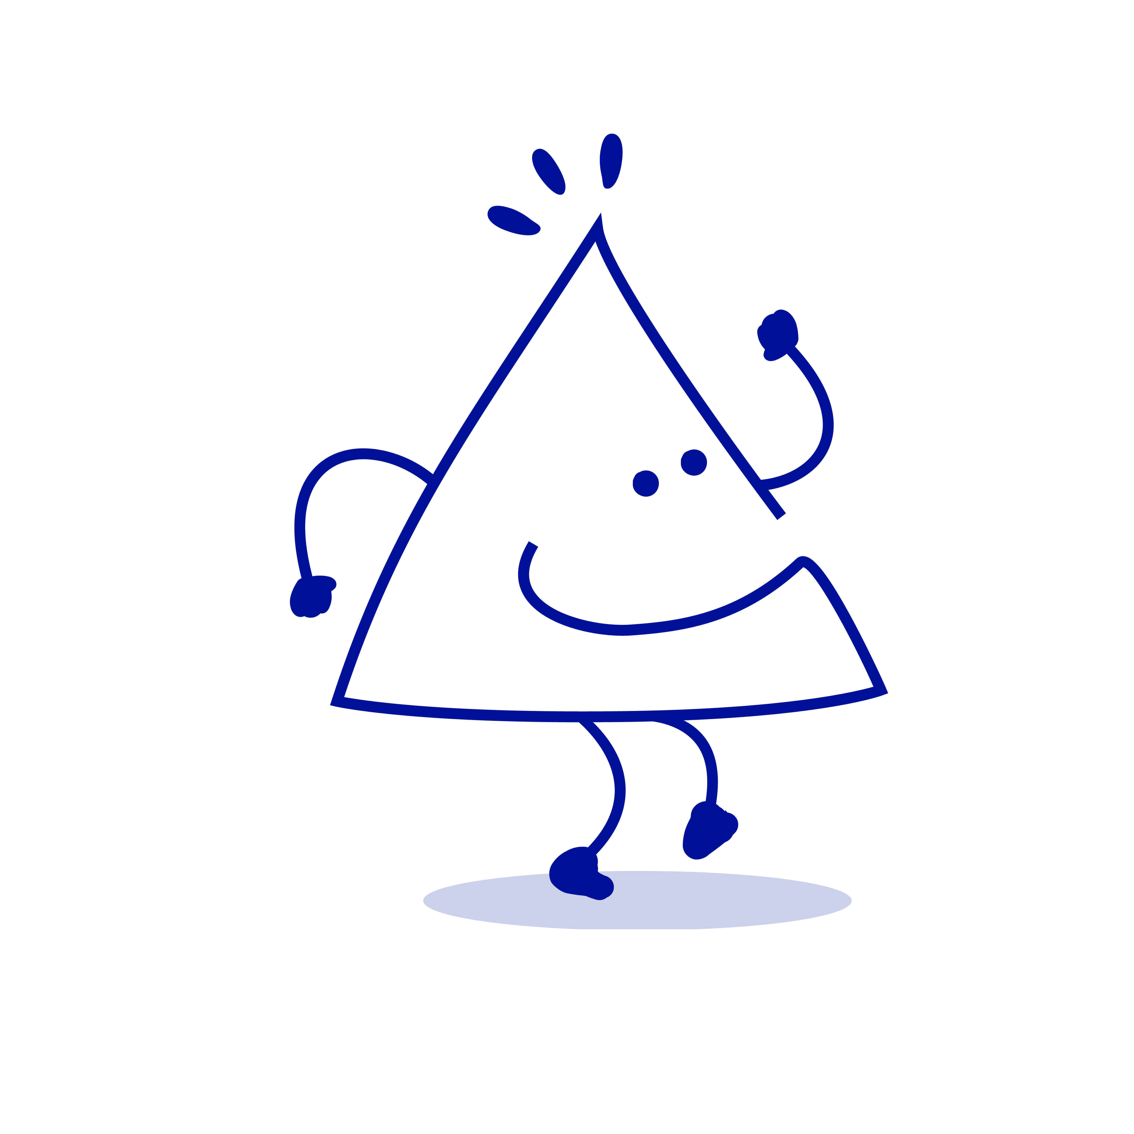
WORKSHOP 1
THEME: INDIVIDUAL VARIABLES
“When I have my smart watch on it tells me to be active. This makes a difference for me”
In response: “In production we can’t wear any technology”
v

Slide 28
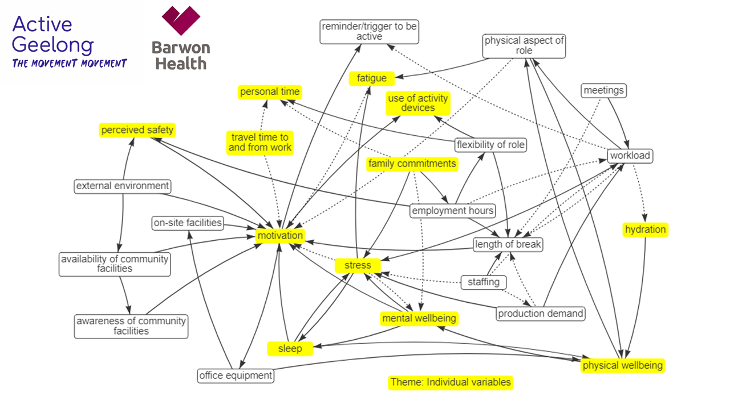
COBRAM ESTATE OLIVES
INDIVIDUAL VARIABLES
ABOUT THE PARTNERS

Slide 29

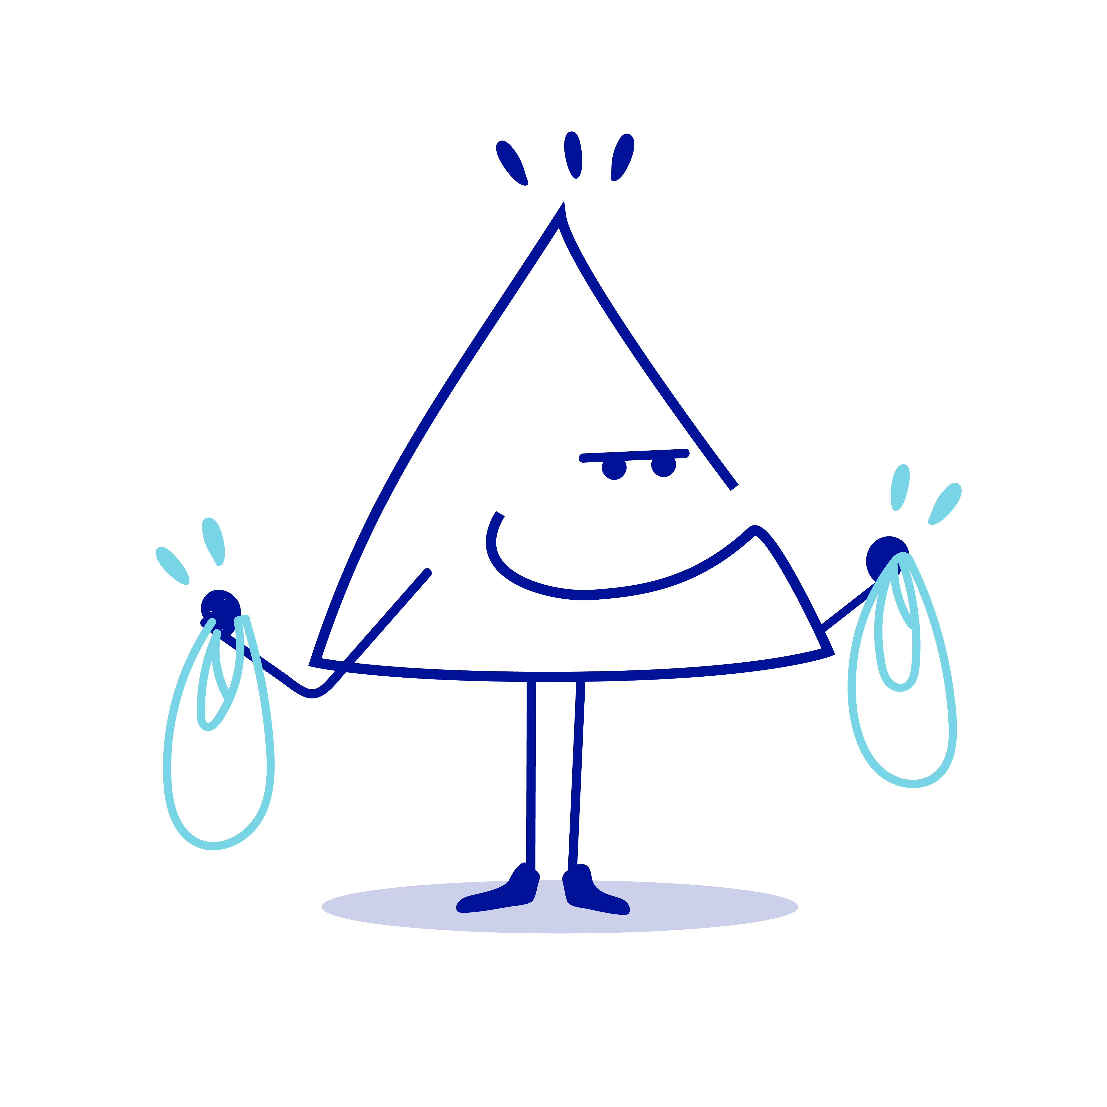
WORKSHOP 2
v
ACTIVE WORKPLACE ACTION IDEAS
MAY 12 2023

Slide 30
WORKSHOP 2
Objective: To generate ideas about how Cobram Estate can support workers to be more physically active.
In workshop two, participants used the visual map of factors to generate and prioritise
a range of actions that could be implemented at Cobram Estate Olives to help them
to increase their physical activity.
The group rated each idea by how impactful they thought the idea would be on the staff population, and how feasible they felt the idea was to implement.
Some of the action ideas related to having more opportunity to be physically active during working hours and outside of working hours. But other ideas targeted workplace processes and other factors that were related to barriers to being physically active.

Slide 31
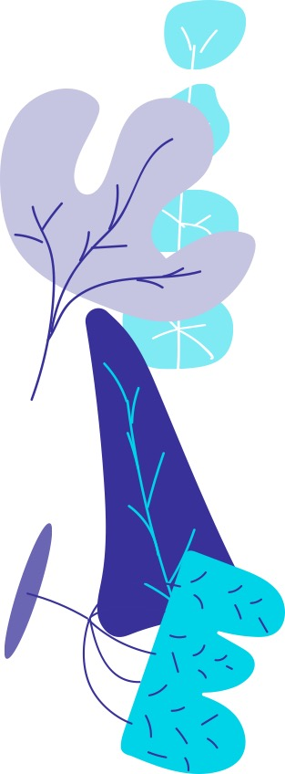

PRIORITISED ACTION IDEAS TO INCREASE PHYSICAL ACTIVITY: SUMMARY
High Impact, Low Feasibility | High Impact, High Feasibility
Minibus to the You Yangs during lunch for walking/running group Onsite gym and shower facilities Fund external activities/membership | Implement walking track on the grounds of Cobram Estate (CE) Onsite exercise classes e.g. Pilates, Personal trainer More flexibility with working and meeting times Reminders/set 5 minute activity breaks to move or stretch throughout work day Health tips from existing CE health professionals e.g. dietitians Team building activities e.g. sports day

Slide 32
PRIORITISED ACTION IDEAS TO INCREASE PHYSICAL ACTIVITY: SUMMARY
Low Impact, Low Feasibility | Low Impact, High Feasibility
Onsite massage Subsidised massage therapy A relaxation room | Time management course

Slide 33
ACTION IDEAS: HIGH IMPACT, HIGH FEASIBILITY
Action idea | Description
Implement walking track on the grounds of Cobram Estate | “To have a walking track around the facility. In the past staff would walk around the facility but now there are trucks. Someone suggested to have targets saying you’ve walked 1km or 2km.”
Onsite exercise classes e.g. Pilates, Personal trainer | “Exercise club: we used to do personal training and Pilates. In the past we had one time once a week. We could offer time slots and have multiple classes and people can take some time out of their day to opt in.”

Slide 34
ACTION IDEAS: HIGH IMPACT, HIGH FEASIBILITY
Action idea | Description
More flexibility with working and meeting times | “For those who are very active or their workload they can’t stop, they can get 5 mins added onto their work break and have it as rest time.” “If you are going to do stuff in lunch you have to bring the business into thinking there is a break, the workload and meetings can’t crowd it.”
Reminders/set 5 minute activity breaks to move or stretch throughout work day | “Short exercise drills would help - either stretching or playing music. Short activity breaks throughout the whole day for the whole site. Triggers people to be active. That could increase activity but also affect the flexibility of your role. If you’re having regular active drills it would make you more active.”

Slide 35
ACTION IDEAS: HIGH IMPACT, HIGH FEASIBILITY
Action idea | Description
Health tips from existing CE health professionals e.g. dietitians | We’ve got dietitian and health professionals who work here, (we) would love to get some monthly tips or a masterclass.”
Team building activities e.g. sports day | “Team building activity, for Easter we did an egg and spoon race and it gets people involved.” “Team building activities - every now and then we have a bbq. It’s not about being active, but maybe we could have it around an event like grand final day. We have done the Escape room at Fyansford and picked a partner that we didn’t work with every day. It was fun. There’s a basketball ring out side.”

Slide 36
HIGH IMPACT, LOW FEASIBILITY
Action idea | Description
Minibus to the You Yangs during lunch for walking/running group | “Once a week a mini bus to go to the You Yangs and go for a walk or run and leaves a certain time and then comes back. This would be high impact.”
Onsite gym and shower facilities | “Talks of onsite gym and shower and I feel like that’s a good idea and anyone can go in there any time. It is very achievable, the gym section would be easier to install than the shower.” “I feel like I would be more likely to use a gym then the walking track. I walk around the warehouse.”

Slide 37
HIGH IMPACT, LOW FEASIBILITY
Action idea | Description
Fund external activities/membership | “Externally the company could fund some memberships or some activity. A swimming or gym membership, running events, play cricket. Not open ended but some type of external (activity).” “Subsidised memberships to local clubs such as $200 towards membership for activity, or corporate membership. People (may not want) to run for 10km but want to stand in cricket field for 4 hours on a Saturday. You can have control over that but when you’re at work you can’t.”

Slide 38
LOW IMPACT, HIGH FEASIBILITY
Action idea | Description
Time management course | “Time management courses so we can better use our time on site and hopefully that would help us manage our time better. Has been on offer already to some of us. It might not even be a course – it could be new tools and tips on how to manage time better.”

Slide 39
LOW IMPACT, LOW FEASIBILITY
Action idea | Description
Onsite massage or subsidised massage therapy | “To have on site massage every six weeks, 15 minutes. May link with relaxation room. It would be really helpful with being on the computer all day.”
A relaxation room | “A relaxation room, where you can de-stress. Helps with mental fatigue. We have a big facility and I think it’s a really feasible idea.”

Slide 40
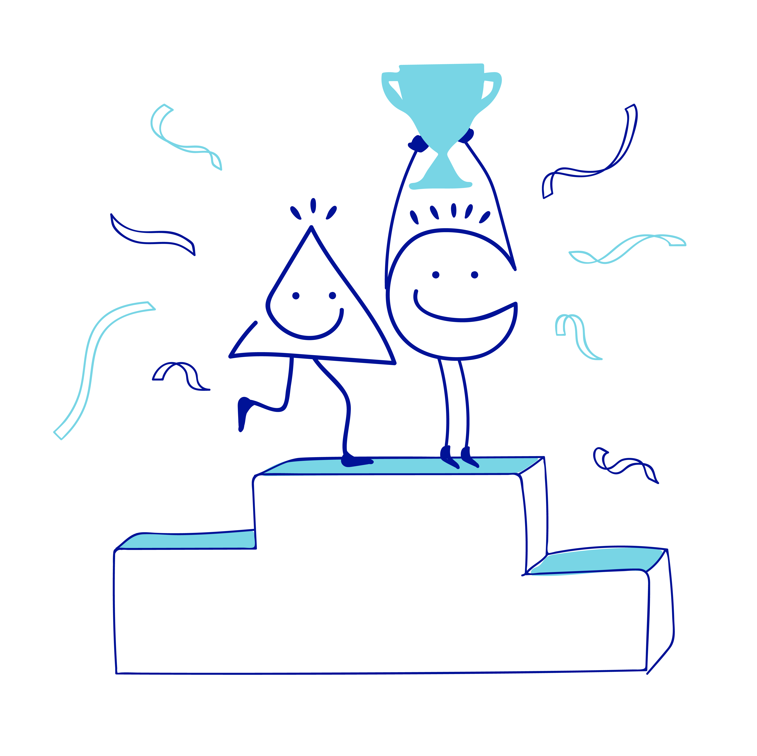
Discuss the action ideas within your workplace and consider where to begin.
Consider the range of physical activity initiatives Active Geelong deliver and if these may be of interest to Cobram Estate.
Barwon Health Healthy Communities team are available to provide workplace health support to Cobram Estate for ongoing design, implementation and evaluation of health and wellbeing initiatives as needed.
Proposed review meeting in 6-12 months to explore progress with physical activity initiatives and to identify any ongoing need for support from Active Geelong and Healthy Communities teams.
NEXT STEPS

Slide 41
PARTICIPANT FEEDBACK
The workshops engaged workers to design solutions to address barriers to being active,
with 100% of participants agreeing the topic of the workshop was relevant, and 73% indicating an interest in being involved in developing future wellbeing initiatives.
In their feedback, participants identified vaping, heathy eating and mental wellbeing
as other health topics they felt were important to address.

Slide 42
THANK YOU
v
CONTACT DETAILS
Active Geelong: mailto:movers@activegeelong.org.au
Barwon Health Healthy Communities Team: healthycommunities@barwonhealth.org.au

